Slide 1
Masters of Illusion
Perspective Quiz

Slide 2
Answer questions #1 and #2. Stop.

Slide 3
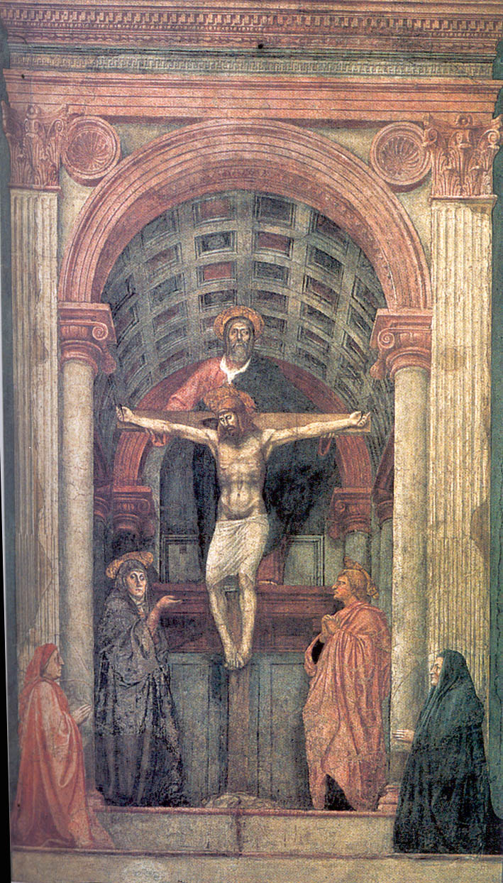
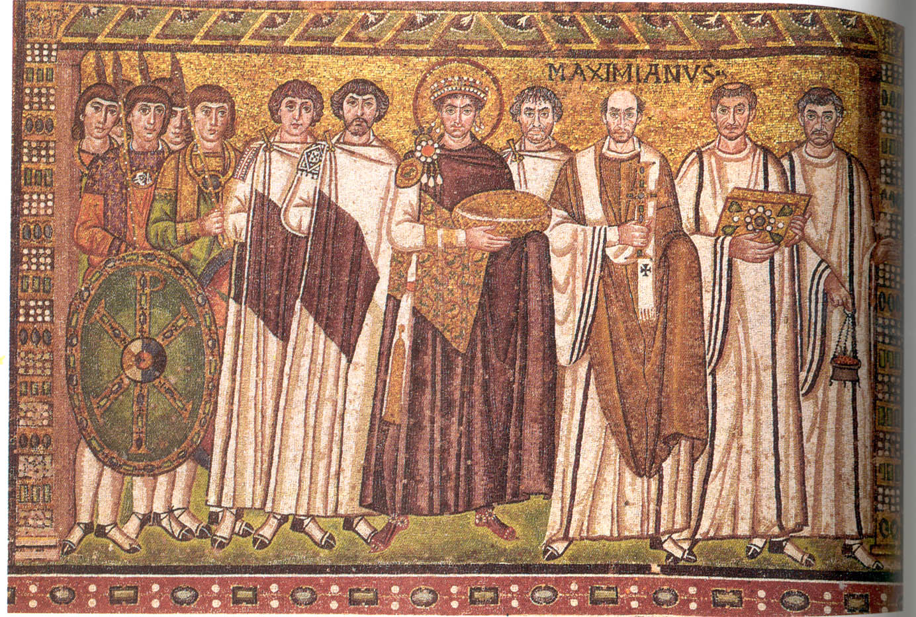
Justinian Massaccio
1. Which one of these two images demonstrates one point perspective? 1 Point
2. Explain your reasoning for question 1. 4 Points

Slide 4
3. What is the name of the historical time period in which artists first developed linear perspective? 1 Point
4. What famous artist was also an inventor, musician and scientist? 2 Points

Slide 5
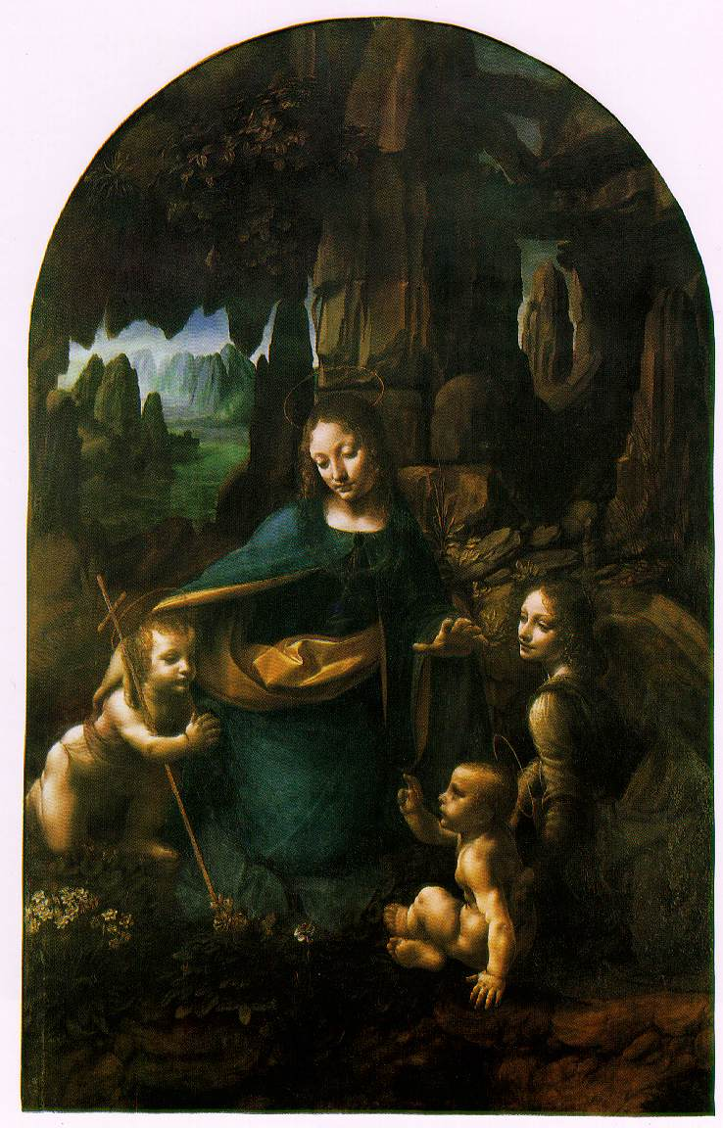
Leonardo Da Vinci Madonna of the Rocks
5. Explain how this image demonstrates ATOMSPHERIC perspective. 4 points

Slide 6
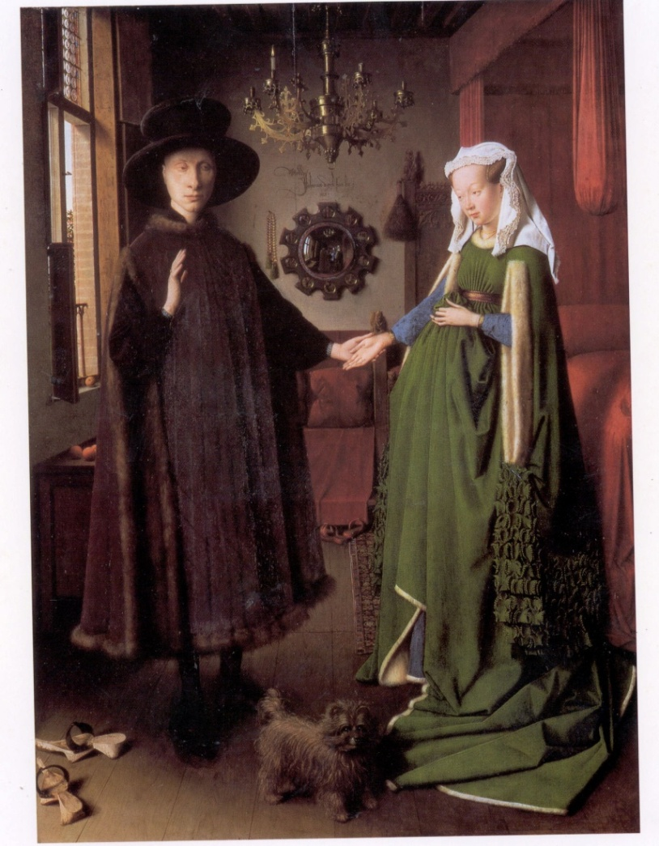
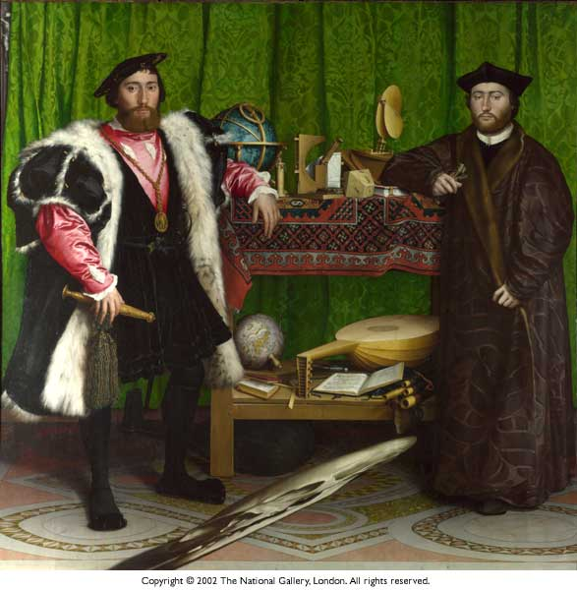
Jan Van Eyck Hans Holbien
6. Which of these two artworks is an example of ANAMORPHIC perspective? 1Point
7. Explain your reasoning behind your answer for question 6. 4Points

Slide 7
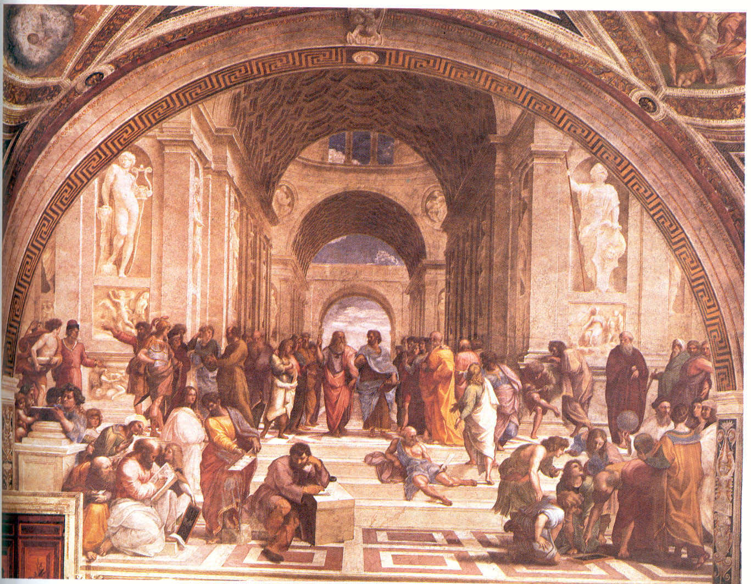
Raphael School of Athens
Name the three great artists that are depicted in this image.
3 Points.

Slide 8
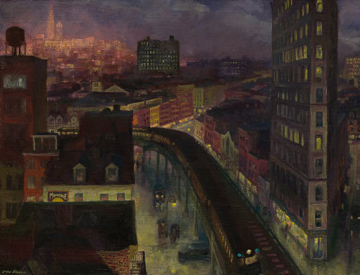
Look at each piece of artwork and list the techniques that were used to create the illusion of depth
1
2
John Sloan The City from Greenwich Village, 1922
Henri Rousseau-Self Portrait (1890)

